Slide 1

Please connect to the cluster while waiting for the session to begin…
Credit: XKCD

Slide 2
An Introduction to HPC Online Training Workshop 2023

Slide 3

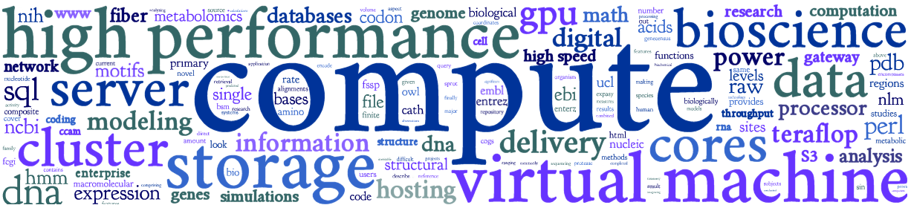
Outcomes of workshop
Overview of Crop Diversity HPC & compute resources
Connect to cluster and complete common tasks
Understand basics of job submissions with Slurm
Use bioconda package manager and containers
Understand basics of workflows
Know cluster etiquette & how to get further help
Compare CPU and GPU processing

Slide 4






Crop Diversity HPC
Initially funded by the BBSRC
For use by:
JHI, NIAB, SRUC
RBGE, RBGK, NHM
3,600 processors
25-gigabit networking
1.7 PB of storage
1.0 PB of backup
500+ users

Slide 5









£2.1m BEIS PSRE Infrastructure (JHI+BioSS)
current additional
1,844C/3,688T CPUs
49x 192GB, 3x 256GB, 2x 384GB
1x 1.5TB, 1x 2TB, 1x 3TB
3x Tesla V100 16/32GB
2x Quadro RTX 8000 48GB
1.7PB primary (~1.2PB usable)
1PB backup (~700TB usable)
25Gbps
2x virtual hosts
3,072C/6,144T CPUs
32x 256GB, 14x 512GB
1x 1TB, 2x 2TB, 1x 4TB
36x Ampere A100 80GB
5PB primary (~3.5PB usable)
3PB backup (~1.7PB usable)
128TB NVMe flash scratch
100Gbps
2x virtual hosts
Compute:
Hi-mem:
GPUs:
Storage:
Networking:
VMware:
plus racks, cabling, UPS, power distribution, additional central IT backup etc…
Notes:
Department for Business, Energy and Industrial Strategy (BEIS) - Public Sector Research Establishments (PSREs)
CPUs: 32C/64T means 32 cores and 64 hyperthreads
Energy draw – if all on, and flat out (however unlikely) – will be 60kW for the new kit, versus about 15kW for current

Slide 6
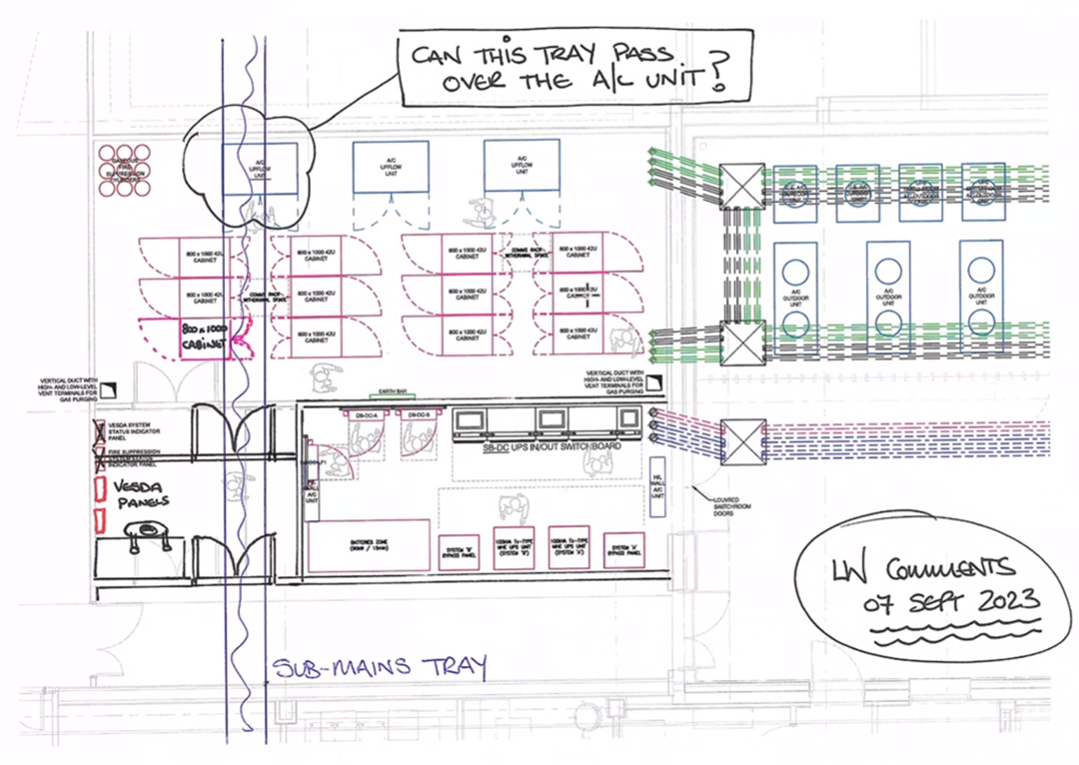
Plus…
Additional £840,000 BBSRC Alert 23 award
delaying any purchases until 2024
hopefully going directly into new data centre
if we can get enough power to run it all

Slide 7
HPC overview
High-performance computing (HPC) is the use of supercomputers and parallel computing techniques to solve complex computational problems
user’s desktop
connect to cluster (SSH)
shared
storage
head node
n1
n2
n3
n4
worker/child/compute nodes
all nodes are running the Linux distribution known as Rocky Linux (version 8.x)
Notes:
Supercomputers vs clusters vs PCs

Slide 8
https://help.cropdiversity.ac.uk/

